Slide 1
SALES DATA ANALYSIS
Milestone - I

Slide 2
DAX Functions
Aggregation Functions:
1. SUM
Total Sales = SUM(Walmart[Sales])
2.AVERAGE
Avg Processing Days = DATEDIFF(Walmart[Order Date], Walmart[Ship Date], Day)
3. COUNT
Total Order Count = COUNT(Walmart[Order ID])

Slide 3
Time Intelligence Functions:
4.DATEDIFF
Processing Days = DATEDIFF(Walmart[Order Date], Walmart[Ship Date], Day)
5.TOTALYTD
Total Sales YTD = TOTALYTD(SUM(Walmart[Sales]), Walmart[Order Date]

Slide 4
Logical Functions:
6. SWITCH
Shipping Speed =
SWITCH(
TRUE(),
Walmart[Processing Days] <= 2,
“Fast Shipping”,
Walmart[Processing Days] <= 5,
“Average Shipping”,
“Slow Shipping”
)

Slide 5
7.IF
Order Type =
IF(
Walmart[Quantity] > 10,
“Bulk Order”,
“ Regular Order”)
Text Functions :
8. CONCATENATE
Customer City =
CONCATENATE (Walmart[Customer Name], “_” & Walmart[City])

Slide 6
Filtering Functions:
9. FILTER
Delayed Orders Count =
CALCULATE (
COUNT(Walmart[Order ID],
FILTER(
Walmart, Walmart[Status] = “Delay”))
Statistical Calculations:
10.Variance
Sales Amount Variance = VAR.P(Walmart[Sales])

Slide 7
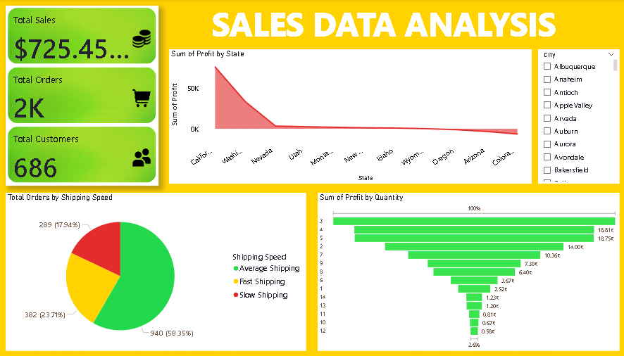
Dashboard

Slide 8
